Slide 1
ANALYSIS OF BUSINESS ENVIRONMENT and DECISION MODELS
Use of SWOT and PESTEL

Slide 2
DEFINITION OF VARIOUS FORMS OF BUSINESS ENVIRONMENT
This is the sum total of all external and internal factors that influence a business. External and internal factors can influence each other and work together to affect a business. Additionally some external factors are beyond our control. These factors are often called external constraints.

Slide 3
EXTERNAL FACTORS
Political factors-government activities and political conditions may affect your business e.g. laws, regulations, tariffs and other trade barriers.
Macroeconomic factors-affect the whole economy and not just the business e.g. interest rates, unemployment rates
Microeconomic factors-affect your business e.g. market size, demand supply ,related with suppliers etc.
Social factors-social relations that affect your business e.g social movements such as environmental movements as well as changes in fashion and consumer preferences.
Technological factors-technological innovations that can either benefit or hurt your business.

Slide 4
INTERNAL FACTORS
Value system-means the ethical beliefs that guide the organization in achieving it's mission and objectives . It also determines it's behavior towards its employees , customers and society at large.
Mission and objectives-its the overall purpose or reason for its existence which guides and influences its business decisions and economic activities e.g. choice of business domain , direction of its development , choice of business strategy n policies.
Organization structure-means things such as composition of board of directors ,number of independent directors , extent of professional management and shareholding pattern .It should be conducive for quick decision making.
Quality of human resources-quality of employees is important as success of a business organizations depends on the skills ,capabilities , attitudes and commitment of its employees.

Slide 5
Internal factors
Labor unions-unions collectively bargain with top managers regarding wages , working conditions of different categories of employees .Smooth working of a business requires that there be good relations between management and labor union.
Physical resources and technological capabilities-physical resources such as plant and equipment and tech capabilities of a firm determine its competitive strength which is an important factor determining it's efficiency and unit cost if production.
Corporate style-often considered as either closed and threatening or open and participatory closed and threatening business decisions are taken by top level managers and junior employees and managers feel left out.
In open and participatory everyone in the company takes part in decision making.

Slide 6
THE INTERNAL ENVIROMENT.

Slide 7
THE INTERNAL ENVIROMENT
An organization’s internal environment is composed of the elements within the organization ,including current employees ,management & especially corporate culture which defines employee behaviour.
Although some elements affect the organisation as a whole ,others only affect the manager. A manager’s philosophical or leadership style directly impacts employees.
Traditional managers give explicit instructions to employees while Progressive managers empower employees to make many of their decisions.
Changes in philosophy and/or style of leadership are under the control of the manager.

Slide 8
THE INTERNAL ENVIROMENT.
Some of the elements making up the environment are;
Mission statement
Formal structure
Organizational culture
Resources
Philosophy of management
https://www.youtube.com/watch?v=eqZOiyO8RLU&spfreload=10

Slide 9
1)MISSION STATEMENT
An organisation’s mission statement describes what the organization stands for and why it exists.
It explains the overall purpose of the organization and includes the attributes that distinguish it from other organizations of its type. It should release its philosophy as well as purpose.
It also provides a focus for an organization by rallying its members to work together to achieve its common goals

Slide 10

2)Formal structure
This is the hierarchical arrangement of tasks & people. This structure determines how information flows within the organisation, which departments are responsible for which activities & where the decision making power rests.

Slide 11
3)Organizational culture
This is the organization's personality. Just as each person has a distinct personality, so does each organization. The culture of an organization distinguishes it from others and shapes the actions of its members.
Four main components make up an organization's culture:
Values
Heroes
Rites and Rituals
Social network

Slide 12
3)ORGANIZATION CULTURE
Values are the basic beliefs that define employees' successes in an organization. For example, many universities place high values on professors being published.
If a faculty member is published in a professional journal, for example, his or her chances of receiving tenure may be enhanced. The university wants to ensure that a published professor stays with the university for the duration of his or her academic career — and this professor's ability to write for publications is a value.

Slide 13
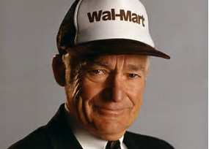

3)ORGANIZATIONAL CULTURE
A hero is an exemplary person who reflects the image, attitudes, or values of the organization and serves as a role model to other employees.
A hero is sometimes the founder of the organization (think Sam Walton of Wal‐Mart). However, the hero of a company doesn't have to be the founder; it can be an everyday worker, such as hard‐working paralegal Erin Brockovich, who had a tremendous impact on the organization.

Slide 14
3)ORGANIZATION CULTURE
Rites and rituals, are routines or ceremonies that the company uses to recognize high‐performing employees. Awards banquets, company gatherings, and quarterly meetings can acknowledge distinguished employees for outstanding service. The honorees are meant to exemplify and inspire all employees of the company during the rest of the year.
The social network is the informal means of communication within an organization. This network, sometimes referred to as the company grapevine, carries the stories of both heroes and those who have failed. It is through this network that employees really learn about the organization's culture and values.

Slide 15
4)RESOURCES
These are the people, information, facilities, infrastructure, machinery, equipment, supplies, and finances at an organization's disposal.
People are the paramount resource of all organizations. Information, facilities, machinery equipment, materials, supplies, and finances are supporting, nonhuman resources that complement workers in their quests to accomplish the organization's mission statement.
The availability of resources and the way that managers value the human and nonhuman resources impact the organization's environment.

Slide 16
5)PHILOSPHY OF MANAGEMENT
This is the manager's set of personal beliefs and values about people and work and as such, is something that the manager can control. McGregor emphasized that a manager's philosophy creates a self‐fulfilling prophecy.
Theory X managers treat employees almost as children who need constant direction, while Theory Y managers treat employees as competent adults capable of participating in work‐related decisions.
These managerial philosophies then have a subsequent effect on employee behaviour, leading to the self‐fulfilling prophecy.

Slide 17
5)PHILOSOPHY OF MANAGEMENT
When guided properly, an empowered workforce may lead to heightened productivity and quality, reduced costs, more innovation, improved customer service, and greater commitment from the employees of the organization.
In addition, response time may improve, because information and decisions need not be passed up and down the hierarchy.

Slide 18
THE EXTERNAL BUSINESS ENVIRONMENT

Slide 19
WHAT IS AN EXTERNAL BUSINESS ENVIRONMENT
The external environment of a business is one where external organizations ,institutions and forces influence on the running of a company
It’s composed of all the outside functions or influences that impact the operation of business
Its made up of two components, the specific environment(micro) and the general environment(macro)

Slide 20
SPECIFIC/MICRO ENVIRONMENT
This is the part of the environment that is directly relevant to the achievement of an organizations goals
Forces that make up the specific environments are customers , suppliers, competitors , pressure groups , trade unions and regulatory bodies

Slide 21
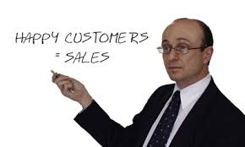
CUSTOMERS
As we all know, organizations exist to meet the needs of customers since they absorb the organizations output.
They represent potential uncertainty to an organisation because they can become dissatisfied with the organisations products or their tastes can change. Therefore managers must make sure that their organisations meet the needs of their customers.

Slide 22
SUPPLIERS
This are organisations that provide inputs required for production of other organisations.
When you think of an organisations suppliers you typically think in terms of those that provide material and equipment, but suppliers also include producers of financial and labour inputs, stockholders ,banks, insurance companies, pension funds. They are also suppliers because they are required to ensure a continuous flow of money.
For example, universities are also suppliers as they are sources of employees and when the sources of employees dry up managers actions and decisions are constrained e.g. lack of qualified nurses make it difficult for health care products to meet demands and keep services high.
Therefore managers need to go great lengths to ensure a steady reliable flow.(Toyota made linkages with suppliers to ensure they get the right material at the right time and place) although linkages manage uncertainty they certainly don’t eliminate it.

Slide 23
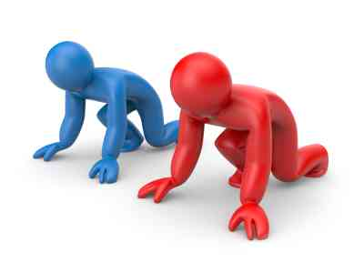
COMPETITORS
All organisations have competitors
Managers must be able to respond to competitors or their organisations will fall.( examples of competing companies like coca cola and Pepsi)
The internet also has a great impact on determining an organisations competitors because it has virtually eliminated geographic boundaries
Hence competitors are an environmental force that managers must monitor and to which they must be prepared to respond
This Photo by Unknown Author is licensed under CC BY

Slide 24


PRESSURE GROUPS
Managers must recognize the special-interest groups that attempt to influence the actions of organisations . For example those companies that put pressure on betting companies

Slide 25

TRADE UNIONS
An organisation whose membership comprises of workers and union leaders to protect and promote their common interests
They negotiate wages and working conditions, regulate relations between workers and their employers , raise new demands on behalf of its members and help settle their grievances an example of a trade union in our country is The Kenya National Union of Teachers(KNUT).
Managers must be able to deal with the pressure from this groups

Slide 26
THE GENERAL/MACRO ENVIRONMENT
It includes the broad external conditions that may affect the organisation. It includes factors that largely lay beyond its influence.
Changes in the conditions affecting macro environments do not have a large impact as changes in the micro environment do, but managers must consider them as they plan organize lead and control.
They include economic conditions, political/legal conditions, social conditions, technological conditions and demographic conditions

Slide 27
ECONOMIC CONDITIONS
Economic conditions play a large part in determining how organisations make their decisions especially when it comes to financial matters.
Interest rates, exchange rates, recessions, inflation, taxes, demand/supply and change in disposable income are some of the examples of this economic conditions.
An example is when consumers income falls they will postpone purchasing anything that isn’t a necessity. Even charitable organisations get affected during economic downturns as the demand for their services increase hence their contributions decrease.

Slide 28

POLITICAL/LEGAL CONDITIONS
Governments influence what organisations can and cannot do.
Organisations spend a great deal of time and money to meet the governments regulations. This laws also limit the choices that managers make.
For example when a manager wants to dismiss an employee there are certain legal processes that he or she must go through since laws and court orders have put increasing orders on what employers may do.
Employees also do have their rights and can decide to take their cases to court when they feel wrongfully discharged. This trend has made it difficult for managers to fire poor performing workers.
Political stability can also influence running of businesses in a country most organisations thrive in a stable political environment. Therefore mangers must aware of political conditions in the countries from which they run their businesses.

Slide 29
SOCIAL/SOCIOCULTURAL CONDITIONS
Managers must adapt their practices according to the changing expectations of society
Organisations must consider that their workers have different wants and needs outside their work life. Managers must consider those with families hence the family leave policy, there should also be flexible work hours and child care facilities, this are just but a few examples of social factors that change the way organisations managed.
Organisations must also consider their workers cultures may it be spiritual or religious. Each of this trends may cause constraint in the way managers make decisions and actions.
However organisations must recognize the values and cultures in the countries where their organisations run and they should manage in ways that embrace them.

Slide 30
DEMOGRAPHIC CONDITIONS
This includes trends in the physical characteristics of a population. Things like gender, age, level of education, geographic location, family composition changes in this characteristics may constrain how a manager carries out his or her activities
For example income, some companies normally appeal to certain income groups there are those for people with high income and those who reach low income groups through discounts retailers and wholesalers.
Another example is age, certain products appeal certain age groups for example younger people are the ones who mostly buy tech products, phones and video games
Managers should therefore be aware of this factors

Slide 31
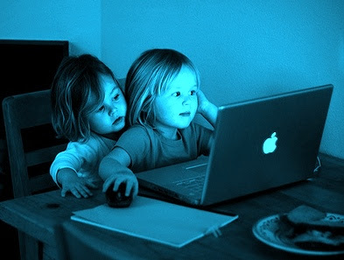
TECHNOLOGICAL CONDITIONS
Technology is radically changing the way organisations are running.
Hospitals, universities, airports, police departments and even military organisations have a competitive edge over those that do not
Mangers should therefore be aware of the technological changes in the industry.
This Photo by Unknown Author is licensed under CC BY-NC-SA

Slide 32
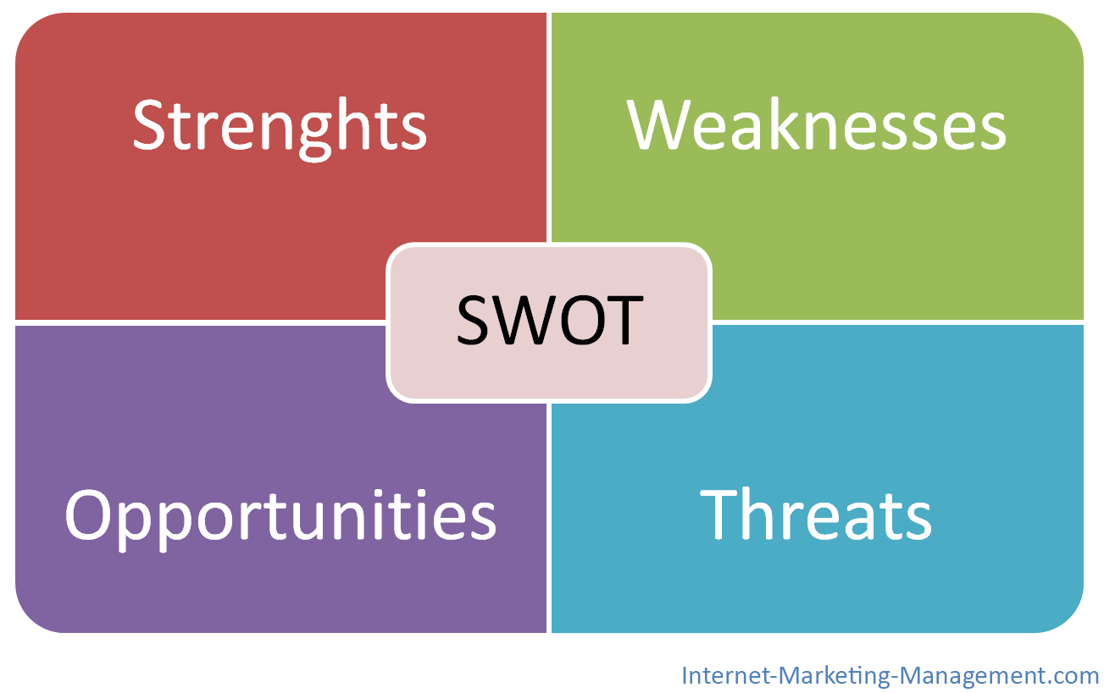
A knowledge based SWOT –analysis system as an instrument for strategic planning in small and medium sized enterprises

Slide 33
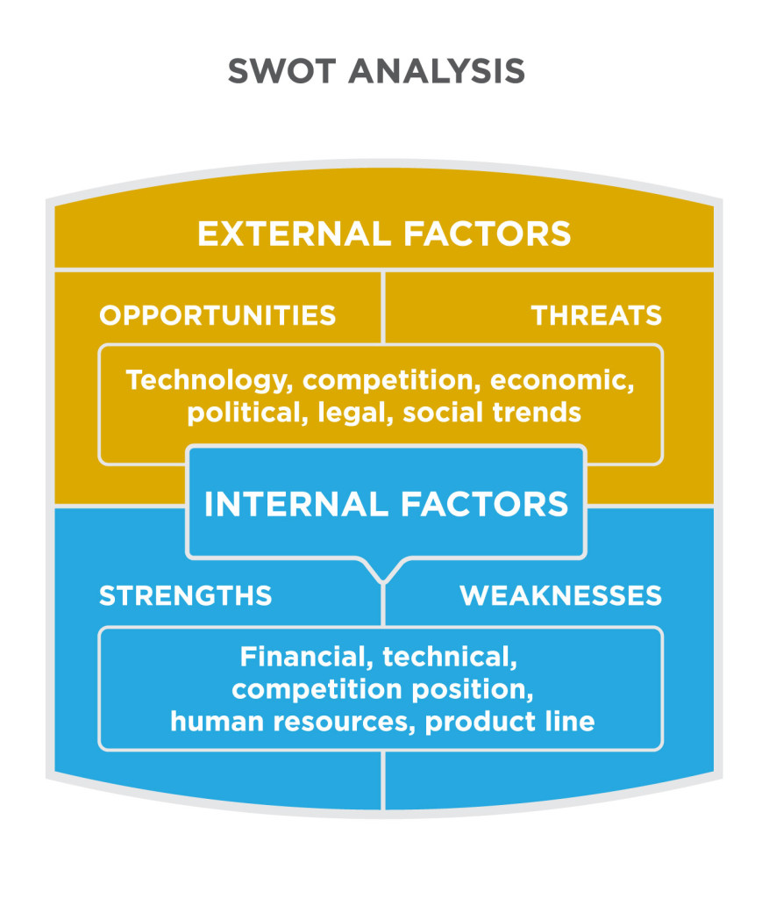
This Photo by Unknown Author is licensed under CC BY

Slide 34
SWOT ANALYSIS
A knowledge based SWOT analysis system as an instrument for strategic planning in small and medium sized enterprises according to G.Houben ,K.Lenie K.Vanhoof, For good performance in a company o take place there should be correct interaction of business management with its external and internal environment .This takes place on the basis of SWOT analysis which stands for strength ,weaknesses, opportunities and threats.

Slide 35
SWOT ANALYSIS
1.1 strengths, weaknesses, opportunities and threats.
Companies are confronted by a variety of internal and external forces , which could be potential stimulants or potential limitations .
Business managers should commence on citing and identifying these factors that support or hinder the company in reaching its full potential.
List of strategic factors can be used as a point of departure for the actual strategic plan within a medium sized enterprise.
It helps the managers of small and medium sized enterprises survey the different management areas ,gain insight into the significance within the frame work of the company and accordingly initiate suitable actions. Strengths relate to the competitive advantages and other distinguishing competencies which can be exploited by the company on the market , (distinguishing competence is something that can be done by the company capably), weaknesses on the other hand refer to limitations which hinder progress of a company

Slide 36
STRATEGIC MANAGEMENT.
Strategic management can be considered as a collection of decisions and actions taken by the business management in consultation with all levels within company to determine the long term activities of the company .
Strategic management includes three basic elements namely:
The formulation of a strategy
Implementation of a strategy
The control and evaluation of the strategy
Before proceeding to these stages a thorough analysis of the companies internal and external environment should first take place .

Slide 37
SWOT ANALYSIS
What is a SWOT analysis and why should you use one?
When do you use SWOT?
What are the elements of a SWOT analysis?
How do you create a SWOT analysis?
How do you use your SWOT analysis?

Slide 38
What is SWOT analysis
What is a SWOT analysis and why should you use one?
SWOT stands for: Strength, Weakness, Opportunity, Threat. A SWOT analysis guides you to identify your organization’s strengths and weaknesses (S-W), as well as broader opportunities and threats (O-T). Developing a fuller awareness of the situation helps with both strategic planning and decision-making.
The strengths of this method are its simplicity and application to a variety of levels o operation.

Slide 39
When do we use SWOT
A SWOT analysis can offer helpful perspectives at any stage of an effort. You might use it to:
Explore possibilities for new efforts or solutions to problems.
Make decisions about the best path for your initiative. Identifying your opportunities for success in context of threats to success can clarify directions and choices.
Determine where change is possible. If you are at a juncture or turning point, an inventory of your strengths and weaknesses can reveal priorities as well as possibilities.
Adjust and refine plans mid-course. A new opportunity might open wider avenues, while a new threat could close a path that once existed.
SWOT also offers a simple way of communicating about your initiative or program and an excellent way to organize information you've gathered from studies or surveys.

Slide 40
SWOT ANALYSIS
SWOT analysis is done so at to reveal positive forces that work together and potential problems that need to be,
recognized and possibly addressed
For Example
Ask the members of your of organization the strengths and weaknesses they undergo as well as the opportunities and
threats for your case study as shown below.
Internal |  | External
Strengths | Weaknesses | Opportunities | Threats

Slide 41
PESTEL ANALYSIS
You remember pestel??
It also a tool for planning and aligning your decisions based on the facts about your external environment.
For all the items go to details and scan the business environment specific to your organization.
https://www.youtube.com/watch?v=N0yqQ9QZKAc

Slide 42


